Slide 1
HR ANALYTICS

Slide 2
Key Highlights:-
Average Tenure – 10.78
Total Employees – 50k
Attrition Rate – 50.21%
Average Percent Salary Hike – 24.62%
Work Life Balance Score – 2.5
Average Overtime Rate – 49.72%
Average Training Hour – 3.49
Average Salary – 26,015
Retention Rate – 49.79%

Slide 3
HR Analytics (also called Workforce Analytics) is the practice of collecting, analyzing, and interpreting employee data to support data-driven decision-making in human resources. The main goal is to optimize workforce performance, improve employee work life experience, job satisfaction, and reduce attrition.
This project focuses on analyzing key HR metrics, identifying patterns, and generating actionable insights that help organizations:-
  Objectives:-
  Understand employee trends and workforce dynamics.
  Measure critical KPIs such as Attrition Rate, Retention Rate, Average Tenure, Average Salary and Work-Life Balance, Hourly Rate, Average Working years.
  Support strategic decisions in recruitment, talent management, training, and employee engagement.
  Forecast future workforce needs and identify risk areas like high attrition or low engagement.

Slide 4
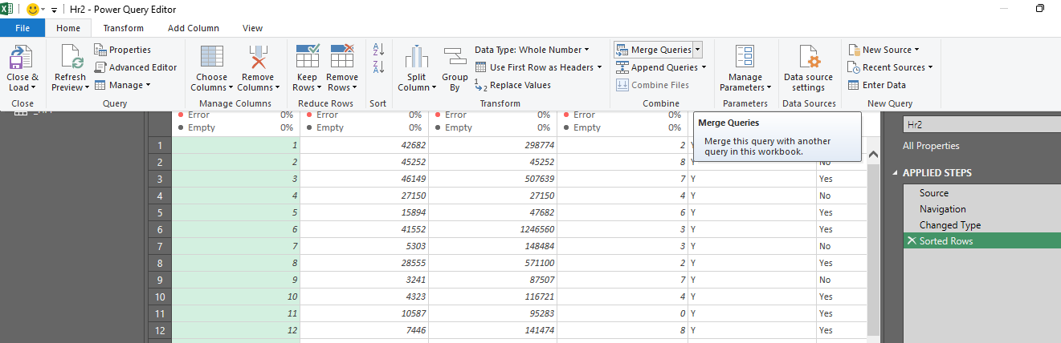
Excel :-
Data preparation:-
Using Power Query → Merge Queries allowed me to combine hr1 and hr2 into a single clean dataset.
While connecting hr1 and hr2 using Employee ID, Excel Power Pivot continuously showed the error “Relationship may be needed” even after validating the data (no duplicates, no blanks, correct data types).
Due to Excel’s stricter relationship engine and row-uniqueness requirements, KPIs pulling columns from both tables were not evaluating correctly.
To ensure accurate analysis, I used Power Query Merge, which creates a clean, single consolidated table. This eliminated relationship conflicts and ensured smooth KPI calculations.

Slide 5
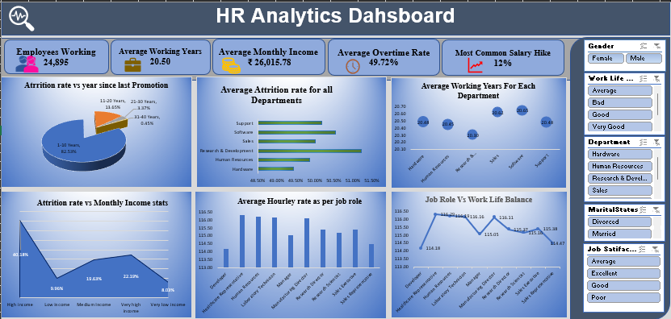
Excel Dashboard:-

Slide 6
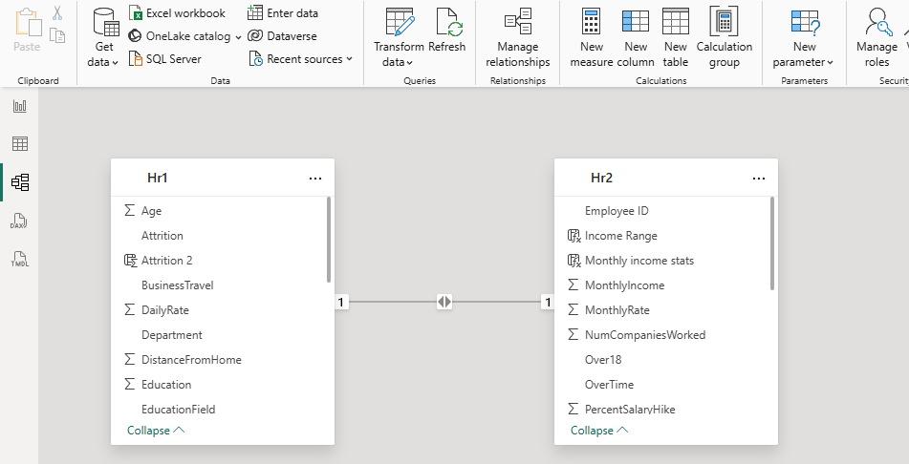
Power BI:-
Data preparation:-
Loaded HR datasets (hr1.xlsx, hr2.xlsx) into Power BI using Get Data → Excel
Verified sheet names, column headers, and data ranges
Created separate queries for each dataset in Power Query Editor.
Data Transformation:-
Created columns (Using DAX) like
Work Life balance range
Job satisfaction range
Year since last promotion bins
Derived Measures (Using DAX)
Attrition Rate
Average Attrition
DATA Modelling:-

Slide 7
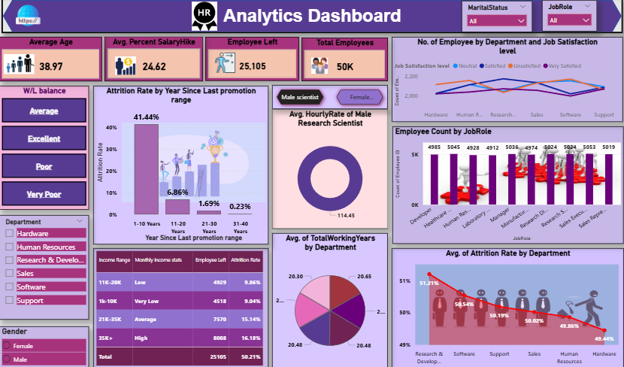
Power Bi Dashboard:-

Slide 8
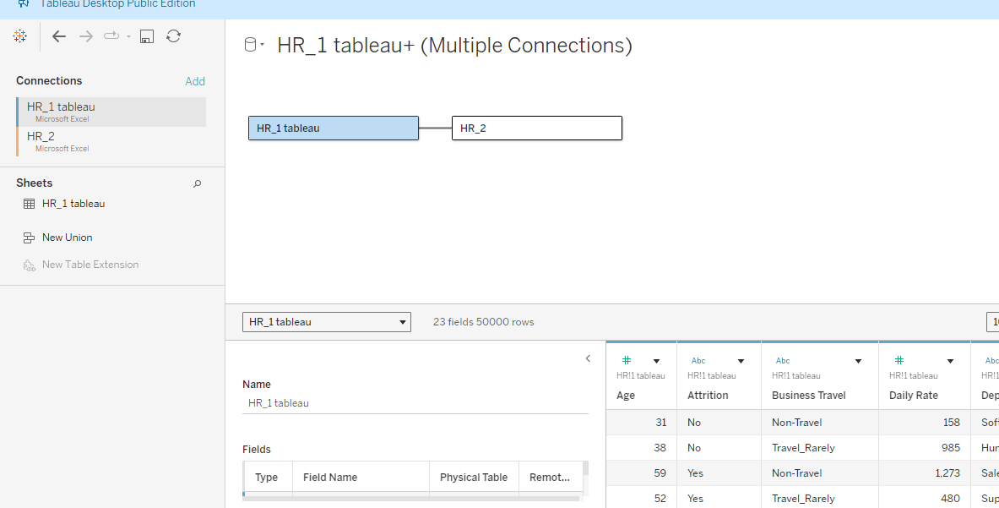
Tableau:-
Data Preparation:-
Loaded HR datasets (hr1.xlsx, hr2.xlsx) into tableau using Connect → To a file → MS Excel
Created relationship in data source pane on physical layer.
Data Transformation:-
Created columns calculated field like
Work Life balance range
Job satisfaction range
Year since last promotion bins
Attrition Rate
Average Attrition
Data Modeling:-

Slide 9
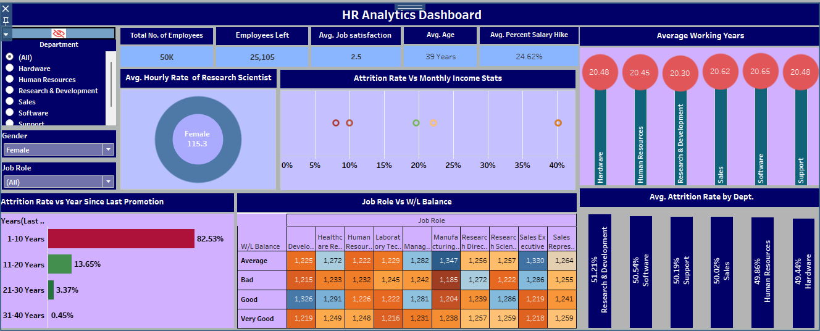
Tableau Dashboard :-

Slide 10
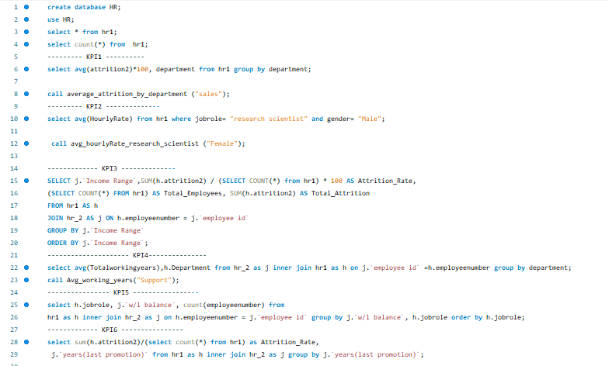
SQL:-
SQL DATA PREPARATION :-
1. Data Import / Data Loading
Loaded raw Excel/CSV HR files (hr1, hr2) into the SQL database.
Used LOAD DATA, INSERT, or import wizard depending on the SQL tool.
Created two main tables:
  hr1 → Employee Master Data
  hr2 → HR Metrics / Performance / Salary Data

Slide 11
Insights:-
1. Department-specific factors (workload, growth opportunities, management practices) have a stronger
impact on attrition than company-wide policies.
Business Actions :
Retention strategies should be department-focused, not generic.
2. In attrition Rate vs Monthly income Compensation is a significant driver of employee turnover,
particularly at early and mid-career levels.
Business Actions:
Targeted salary adjustments and incentive programs can reduce attrition in high-risk income segments.
3. In Average working years by department lower tenure may indicate role misalignment, high stress, or
limited growth opportunities.
Business Actions:
Improving career paths and internal mobility like internal job posting can stabilize workforce tenure.
4. Roles with poor work-life balance are more likely to experience disengagement and attrition.
Business Actions:
Redesigning workloads and offering flexible work policies can improve employee satisfaction and
retention.
5. Employees who experience career stagnation are more likely to leave the organization.
Business Actions:
Clear promotion timelines and transparent career progression reduce turnover risk.

